Slide 1
AI/ML Professional Training Program: INNOQUEST Cohort-1
1
Instructor
Ansar Rahman
Artificial Intelligence Diagnostics Lab
FAST National University of Computer and Emerging Sciences
AI/ML Professional Training Program: INNOQUEST COHORT-1
Instructor: Mr. Ansar Rahman

Slide 2
Content
What is Reinforcement Learning
Key concepts in RL
Types of RL Algorithms
Q-Learning
Bellman Equation
Q-Learning Example
Applications of RL
AI/ML Professional Training Program: INNOQUEST COHORT-1
Instructor: Mr. Ansar Rahman

Slide 3
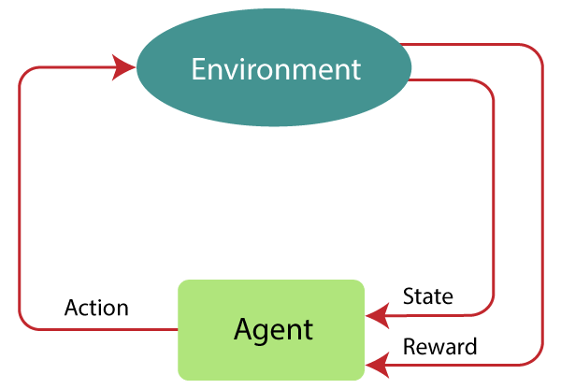
What is reinforcement learning?
Reinforcement learning is a type of machine learning in which an agent explores an environment to learn how to perform desired tasks by taking actions with good outcomes and avoiding actions with bad outcomes.
AI/ML Professional Training Program: INNOQUEST COHORT-1
Instructor: Mr. Ansar Rahman
Notes:
RL is centered around the concept of learning by interaction. This means that in RL, the model learns from interactions with an environment to maximize a reward function.

Slide 4
Components of RL
Agent: an entity that learns how to make decisions and interacts with its surrounding environment by taking an action.
Environment: anything that falls outside the agent. The environment communicates with the agent and determines the reward signal for the agent’s action as well as its observations.
State: A representation of the current situation in the environment.
Action: A decision or move made by the agent at a given state.
AI/ML Professional Training Program: INNOQUEST COHORT-1
Instructor: Mr. Ansar Rahman

Slide 5
Components of RL
Value: It is expected long-term return with discount, as compared to the short-term reward.
Reward: Feedback from the environment in response to the agent's action. Rewards guide the learning process.
Policy: The strategy or mapping from states to actions that the agent
follows. It can be deterministic or stochastic.
Episodes: the end of the stage, where agents can’t take new action. It happens when the agent has achieved the goal or failed.
AI/ML Professional Training Program: INNOQUEST COHORT-1
Instructor: Mr. Ansar Rahman

Slide 6
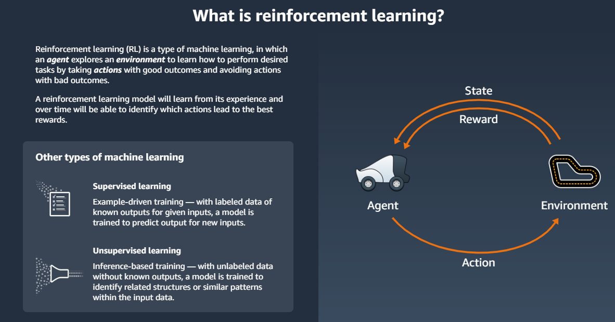
What is reinforcement learning?
AI/ML Professional Training Program: INNOQUEST COHORT-1
Instructor: Mr. Ansar Rahman
Notes:
RL is centered around the concept of learning by interaction. This means that in RL, the model learns from interactions with an environment to maximize a reward function.

Slide 7
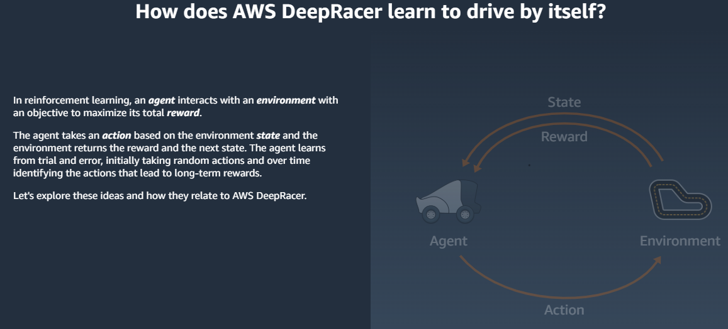
AI/ML Professional Training Program: INNOQUEST COHORT-1
Instructor: Mr. Ansar Rahman
Notes:
RL is centered around the concept of learning by interaction. This means that in RL, the model learns from interactions with an environment to maximize a reward function.

Slide 8
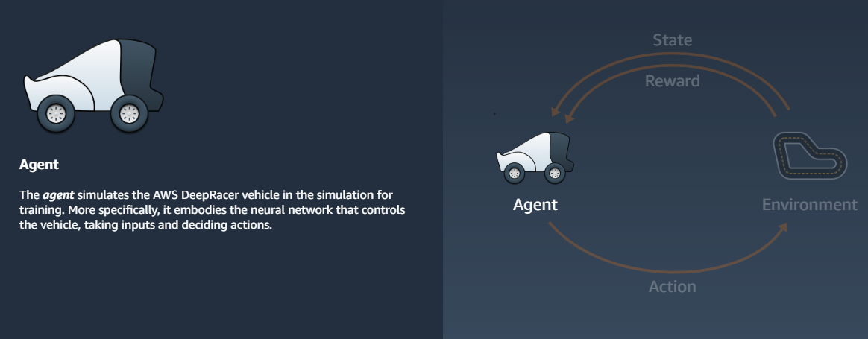
Agent
AI/ML Professional Training Program: INNOQUEST COHORT-1
Instructor: Mr. Ansar Rahman
Notes:
RL is centered around the concept of learning by interaction. This means that in RL, the model learns from interactions with an environment to maximize a reward function.

Slide 9
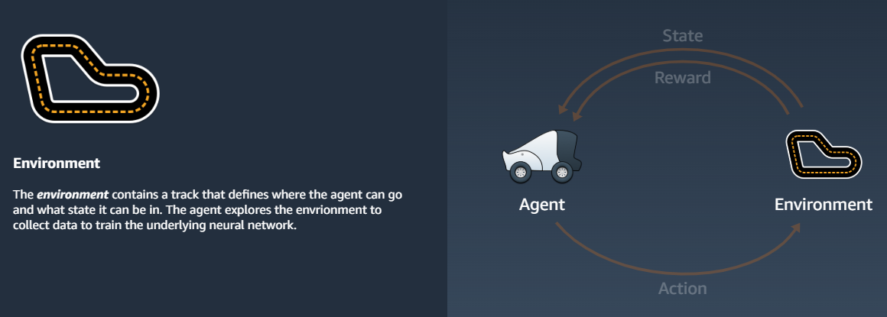
Environment
AI/ML Professional Training Program: INNOQUEST COHORT-1
Instructor: Mr. Ansar Rahman
Notes:
RL is centered around the concept of learning by interaction. This means that in RL, the model learns from interactions with an environment to maximize a reward function.

Slide 10
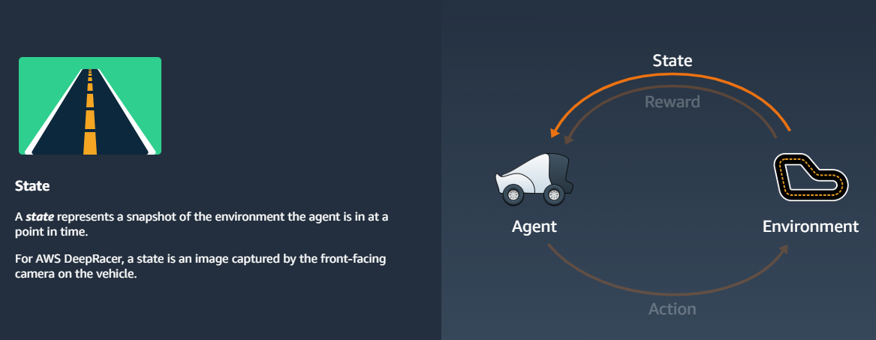
State
AI/ML Professional Training Program: INNOQUEST COHORT-1
Instructor: Mr. Ansar Rahman
Notes:
RL is centered around the concept of learning by interaction. This means that in RL, the model learns from interactions with an environment to maximize a reward function.

Slide 11
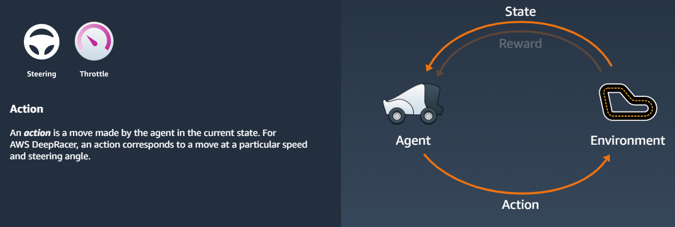
Action
AI/ML Professional Training Program: INNOQUEST COHORT-1
Instructor: Mr. Ansar Rahman
Notes:
RL is centered around the concept of learning by interaction. This means that in RL, the model learns from interactions with an environment to maximize a reward function.

Slide 12
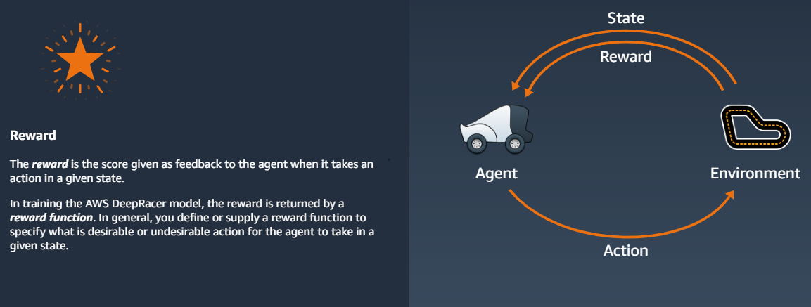
Reward
AI/ML Professional Training Program: INNOQUEST COHORT-1
Instructor: Mr. Ansar Rahman
Notes:
RL is centered around the concept of learning by interaction. This means that in RL, the model learns from interactions with an environment to maximize a reward function.

Slide 13
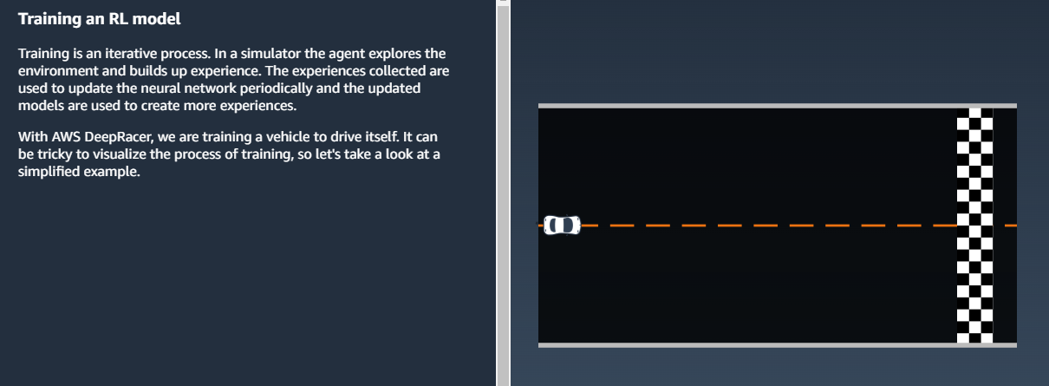
Training an RL Model
AI/ML Professional Training Program: INNOQUEST COHORT-1
Instructor: Mr. Ansar Rahman
Notes:
RL is centered around the concept of learning by interaction. This means that in RL, the model learns from interactions with an environment to maximize a reward function.

Slide 14
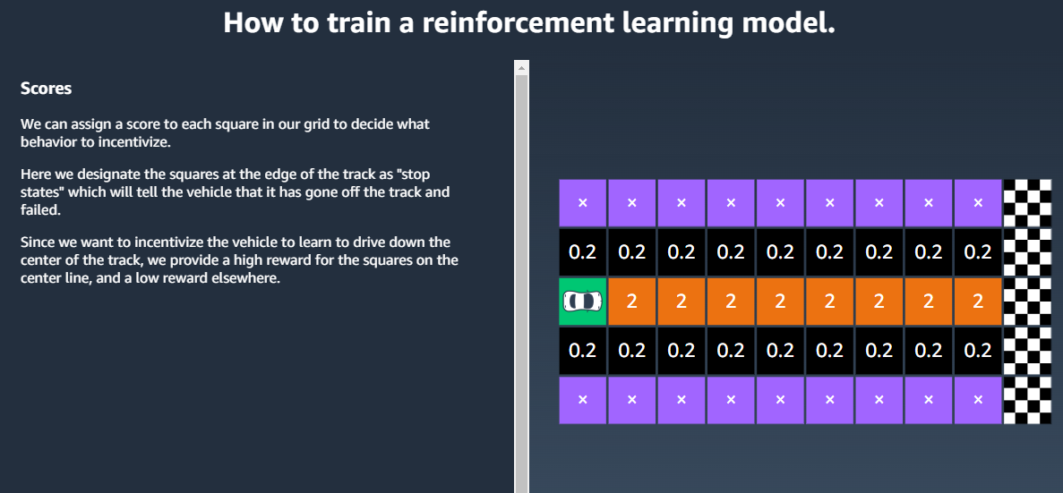
Training an RL Model
AI/ML Professional Training Program: INNOQUEST COHORT-1
Instructor: Mr. Ansar Rahman
Notes:
RL is centered around the concept of learning by interaction. This means that in RL, the model learns from interactions with an environment to maximize a reward function.

Slide 15
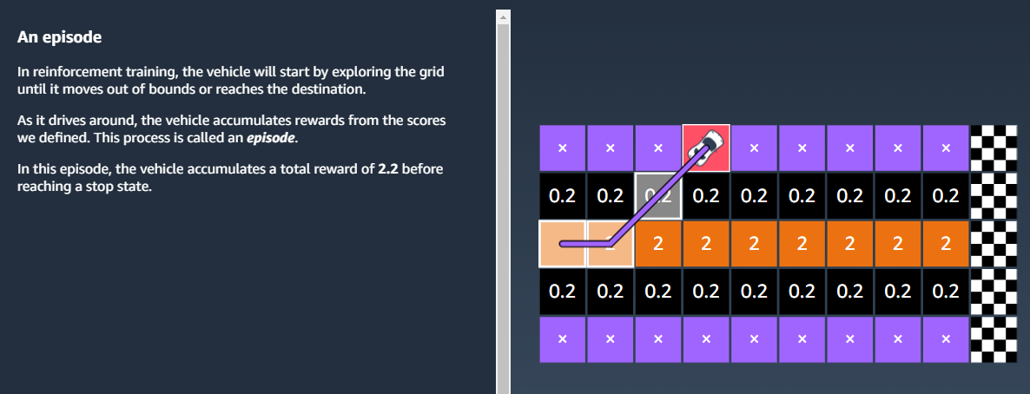
An Episode
AI/ML Professional Training Program: INNOQUEST COHORT-1
Instructor: Mr. Ansar Rahman
Notes:
RL is centered around the concept of learning by interaction. This means that in RL, the model learns from interactions with an environment to maximize a reward function.

Slide 16
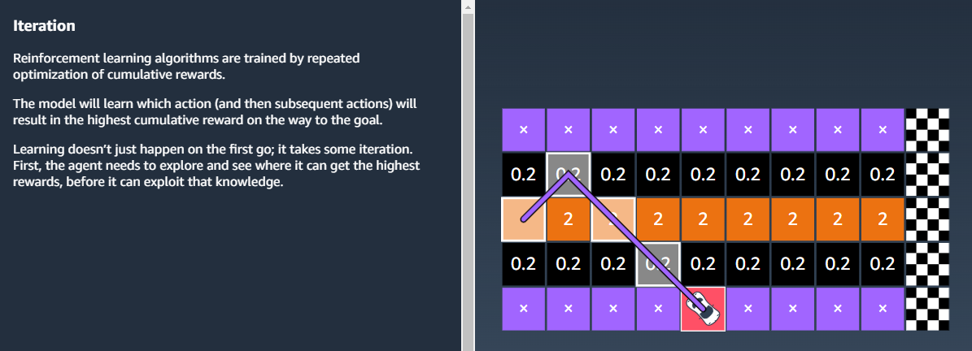
Iteration
AI/ML Professional Training Program: INNOQUEST COHORT-1
Instructor: Mr. Ansar Rahman
Notes:
RL is centered around the concept of learning by interaction. This means that in RL, the model learns from interactions with an environment to maximize a reward function.

Slide 17
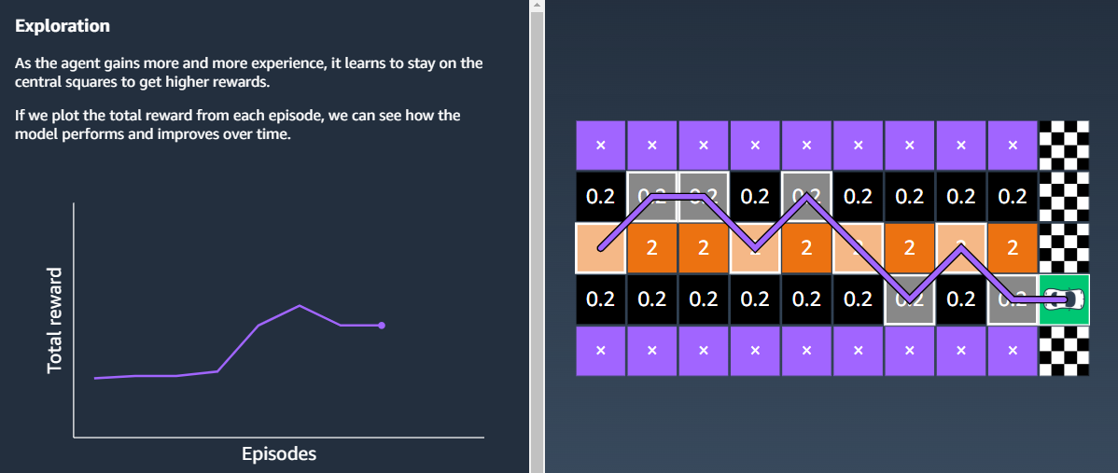
Exploration: Trying new actions to discover potentially better rewards.
AI/ML Professional Training Program: INNOQUEST COHORT-1
Instructor: Mr. Ansar Rahman
Notes:
RL is centered around the concept of learning by interaction. This means that in RL, the model learns from interactions with an environment to maximize a reward function.

Slide 18
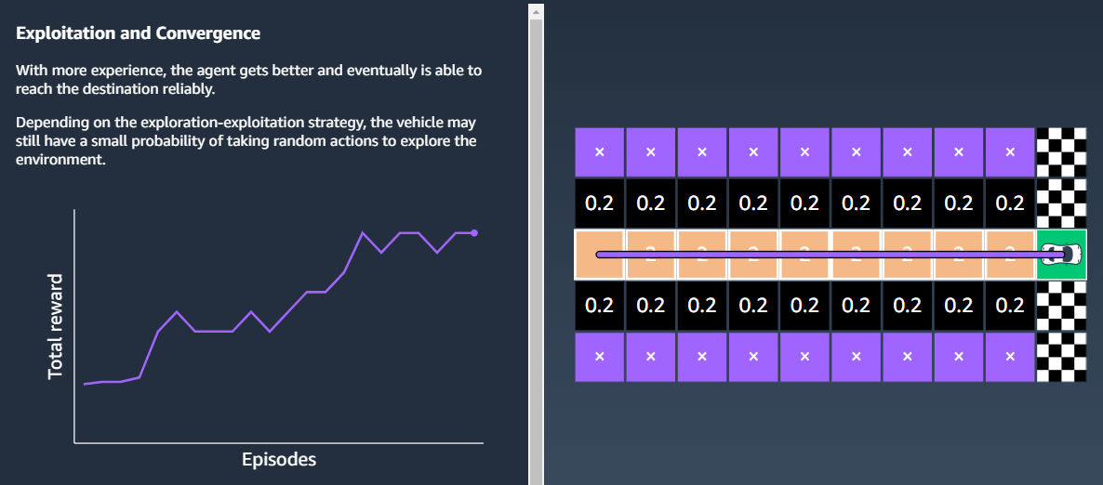
Exploitation: Using the best-known actions to maximize rewards.
AI/ML Professional Training Program: INNOQUEST COHORT-1
Instructor: Mr. Ansar Rahman
Notes:
RL is centered around the concept of learning by interaction. This means that in RL, the model learns from interactions with an environment to maximize a reward function.

Slide 19
Components of RL
Value Function: It specifies the value of a state that is the total amount of reward.
State-Value Function (V(s)):
Estimates the long-term return (expected cumulative reward) from a given state S
Helps in evaluating how good a state is for the agent
Action-Value Function (Q( s, a)):
Estimate the value of taking action (a) in state (s).
Useful for determining which action to choose in a state.
AI/ML Professional Training Program: INNOQUEST COHORT-1
Instructor: Mr. Ansar Rahman
Notes:
During the learning process, the agent must try different actions (exploration) so that it can progres sively learn which actions to prefer and perform more often (exploitation) in order to maximize the total, cumulative reward. To understand this concept, let’s consider a very simple example where a new computer science graduate with a focus on software engineering is wondering whether to start working at a company (exploitation) or to pursue a master’s or Ph.D. degree to learn more about data science and machine learning (exploration). In general, exploitation will result in choosing actions with a greater short-term reward, whereas exploration can potentially result in greater total rewards in the long run. The tradeoff between exploration and exploitation has been studied extensively, and yet, there is no universal answer to this decision-making dilemma.

Slide 20
Types of RL algorithms
RL algorithms can be categorized based on how they make agents interact with the environment and learn from experience. The categories of RL algorithms are:
Value-Based RL
Policy-based RL
Model-Based RL
Model-free RL
Off-policy
On-policy
AI/ML Professional Training Program: INNOQUEST COHORT-1
Instructor: Mr. Ansar Rahman
Notes:
The value-based method trains the value function to learn which state is more valuable and take action. On the other hand,
policy-based methods train the policy directly to learn which action to take in a given state.
In the off-policy, the algorithm evaluates and updates a policy that differs from the policy used to take an action.
Conversely, the on-policy algorithm evaluates and improves the same policy used to take an action.

Slide 21
Value-based RL
In a value-based Reinforcement Learning method, you should try to maximize a value function V(s).
In this method, the agent is expecting a long-term return of the current states under policy π
AI/ML Professional Training Program: INNOQUEST COHORT-1
Instructor: Mr. Ansar Rahman

Slide 22
Policy-based RL
In a policy-based RL method, you try to come up with such a policy that the action performed in every state helps you to gain maximum reward in the future.
Two types of policy-based methods are:
Deterministic: For any state, the same action is produced by the policy π.
Stochastic: Every action has a certain probability, which is determined by the standard parameters
AI/ML Professional Training Program: INNOQUEST COHORT-1
Instructor: Mr. Ansar Rahman

Slide 23
Model based
In this RL method, you need to create a virtual model for each environment. The agent learns to perform in that specific environment.
The agent predicts how the environment behaves. Think of it like planning before acting.
AI/ML Professional Training Program: INNOQUEST COHORT-1
Instructor: Mr. Ansar Rahman
Notes:
The model-based algorithms use transition and reward functions to estimate the optimal policy and create the model.
the agent tries to build a model of the environment. The model predicts how the environment behaves when the agent takes an action.

Slide 24
Model free
In this type, the agent does not try to understand or predict the environment's behavior. Instead, it learns directly from its experiences (trial and error).
The agent learns purely from trial and error. Think of it like “learning by doing.”
Some common model-free RL algorithms include:
Q-Learning
SARSA (State-Action-Reward-State-Action)
Policy gradient methods
Deep Q-Networks (DQN)
AI/ML Professional Training Program: INNOQUEST COHORT-1
Instructor: Mr. Ansar Rahman
Notes:
Some common model-free RL algorithms include:
Q-Learning: The algorithm learns a Q-value for each state-action pair. The Q-value represents the expected future reward of taking a specific action in a particular state. The agent can then choose the action with the highest Q-value to maximize its long-term reward (we’ll explain this in more detail in the next section).
SARSA (State-Action-Reward-State-Action): This is similar to Q-learning, but it learns a value function for each state-action pair. It updates the value based on the reward received after taking an action and the next state observed.
Policy gradient methods: These algorithms directly learn the policy function, which maps states to actions. They use gradients to update the policy in the direction expected to lead to higher rewards. Examples include REINFORCE and Proximal Policy Optimization (PPO).
Deep Q-Networks (DQN): This algorithm combines Q-learning with deep neural networks to handle high-dimensional state spaces, often encountered in complex environments like video games.
model-free algorithms learn the consequences of their actions through the experience without transition and reward function.

Slide 25
Off and on-Policy based RL
In the off-policy, the algorithm evaluates and updates a policy that differs from the policy used to take an action.
The on-policy algorithm evaluates and improves the same policy used to take an action.
AI/ML Professional Training Program: INNOQUEST COHORT-1
Instructor: Mr. Ansar Rahman

Slide 26
What is Q-Learning
Q-learning is a model-free, value-based, off-policy algorithm that finds the best series of actions based on the agent's current state.
The “Q” stands for quality. Quality represents how valuable the action is in maximizing future rewards.
Q-learning is a practical algorithm that uses the Bellman Equation to iteratively update the Q-values (action-value function).
AI/ML Professional Training Program: INNOQUEST COHORT-1
Instructor: Mr. Ansar Rahman
Notes:
Q-learning is a model-free algorithm that teaches agents the optimal winning strategy through smart interactions with the environment.
A model-free RL algorithm that learns the value of actions to maximize rewards.
Learn a Q-Function (Q(s,a)) that predicts the expected reward for taking action a in state s.

Slide 27
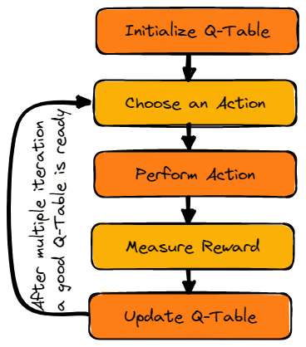
Q-Learning algorithm high level steps
AI/ML Professional Training Program: INNOQUEST COHORT-1
Instructor: Mr. Ansar Rahman

Slide 28
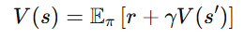
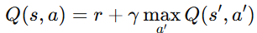
Bellman equation
A recursive relationship for the value of a state under a given policy.
State-Value Function (V(s)):
r: Reward for current action.
γ: Discount factor (importance of future rewards).
V(s′): Value of the next state.
Action-Value Function (Q( s, a)):
AI/ML Professional Training Program: INNOQUEST COHORT-1
Instructor: Mr. Ansar Rahman

Slide 29
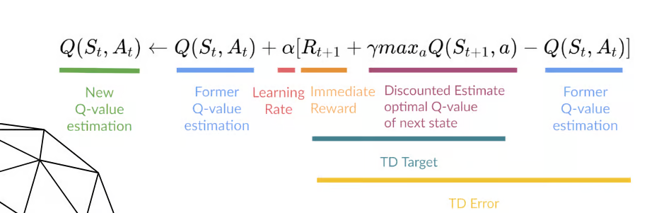
Q-Learning Update rule
Q-Learning uses the Bellman Optimality Equation to update the Q-values as follows:
Q(s,a): Current estimate of the value of taking action (a) in state (s).
R: Immediate reward received after taking action (a) in state (s).
maxa′​Q(s′,a′): Highest Q-value for the next state s′, representing the best possible future reward
TD Error: [R+γmax⁡a′Q(s′,a′)−Q(s,a)], the difference between the current Q-value and the new target value
AI/ML Professional Training Program: INNOQUEST COHORT-1
Instructor: Mr. Ansar Rahman
Notes:
We will update the function Q(S_{t}, A_{t}) using the equation. It uses the previous episode’s estimated Q-values, learning rate, and Temporal Differences error. Temporal Differences error is calculated using Immediate reward, the discounted maximum expected future reward, and the former estimation Q-value.
The process is repeated multiple times until the Q-Table is updated and the Q-value function is maximized.
This term adjusts our current Q-value to include a portion of the rewards it may receive sometime in the future (St+1). The 'a' term refers to all the possible actions available for that state. The equation also contains two hyperparameters which we can specify:
Learning rate (α): how easily the agent should accept new information over previously learnt information
Discount factor (γ): how much the agent should take into consideration the rewards it could receive in the future versus its immediate reward
Q(S_{t+1}, a): expected optimal Q-value of doing the action in a particular state.
Q(S_{t}, A_{t}): it is the current estimation of Q(S_{t+1}, a).
Temporal Differences(TD): used to estimate the expected value of Q(S_{t+1}, a) by using the current state and action and previous state and action.

Slide 30
Q-Table
The agent will use a Q-table to take the best possible action based on the expected reward for each state in the environment.
In simple words, a Q-table is a data structure of sets of actions and states, and we use the Q-learning algorithm to update the values in the table.
AI/ML Professional Training Program: INNOQUEST COHORT-1
Instructor: Mr. Ansar Rahman
Notes:
Q-Table: the agent maintains the Q-table of sets of states and actions.

Slide 31
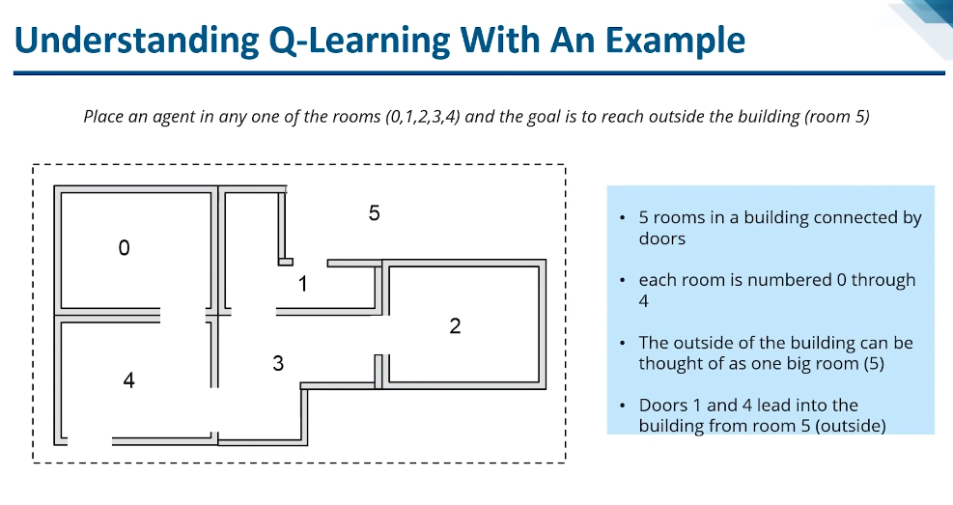
What is Q-Learning
AI/ML Professional Training Program: INNOQUEST COHORT-1
Instructor: Mr. Ansar Rahman
Notes:
Q-learning is a model-free algorithm that teaches agents the optimal winning strategy through smart interactions with the environment.
A model-free RL algorithm that learns the value of actions to maximize rewards.
Learn a Q-Function (Q(s,a)) that predicts the expected reward for taking action a in state s.

Slide 32
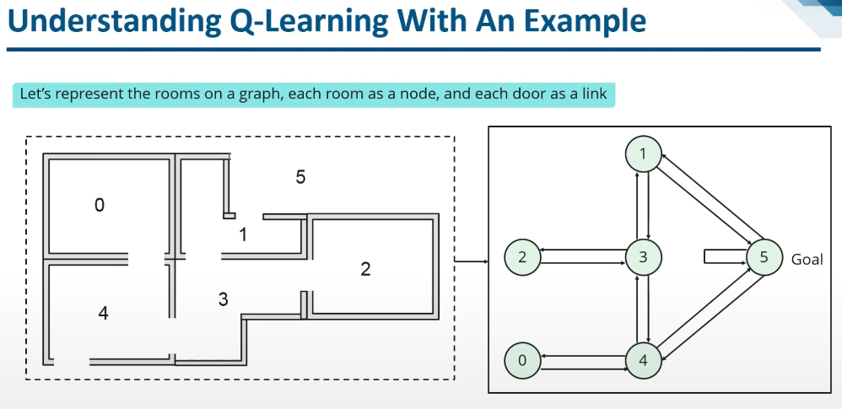
What is Q-Learning
AI/ML Professional Training Program: INNOQUEST COHORT-1
Instructor: Mr. Ansar Rahman
Notes:
Q-learning is a model-free algorithm that teaches agents the optimal winning strategy through smart interactions with the environment.
A model-free RL algorithm that learns the value of actions to maximize rewards.
Learn a Q-Function (Q(s,a)) that predicts the expected reward for taking action a in state s.

Slide 33
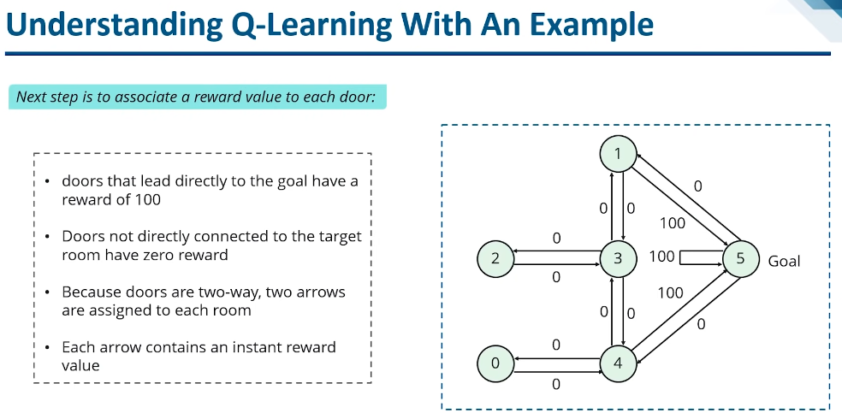
What is Q-Learning
AI/ML Professional Training Program: INNOQUEST COHORT-1
Instructor: Mr. Ansar Rahman
Notes:
Q-learning is a model-free algorithm that teaches agents the optimal winning strategy through smart interactions with the environment.
A model-free RL algorithm that learns the value of actions to maximize rewards.
Learn a Q-Function (Q(s,a)) that predicts the expected reward for taking action a in state s.

Slide 34
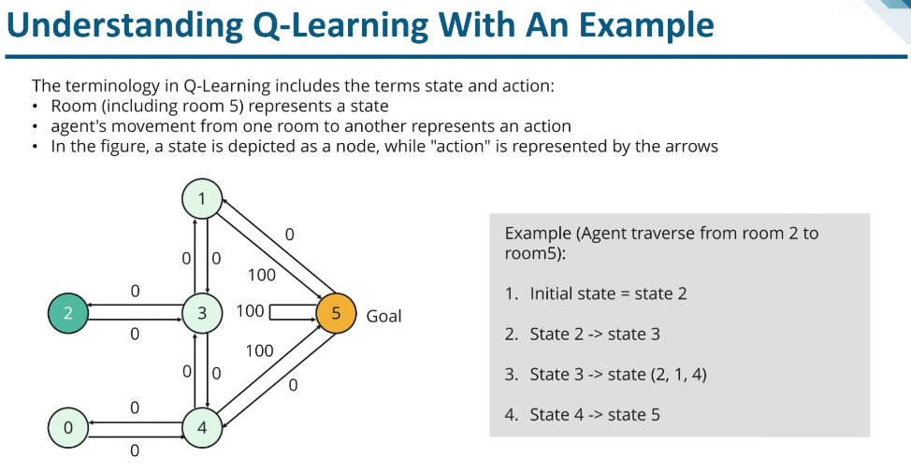
What is Q-Learning
AI/ML Professional Training Program: INNOQUEST COHORT-1
Instructor: Mr. Ansar Rahman
Notes:
Q-learning is a model-free algorithm that teaches agents the optimal winning strategy through smart interactions with the environment.
A model-free RL algorithm that learns the value of actions to maximize rewards.
Learn a Q-Function (Q(s,a)) that predicts the expected reward for taking action a in state s.

Slide 35
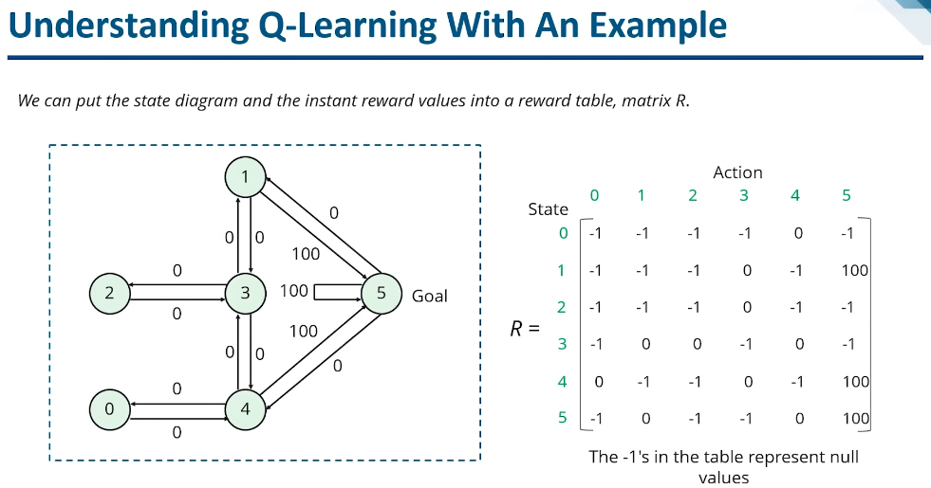
What is Q-Learning
AI/ML Professional Training Program: INNOQUEST COHORT-1
Instructor: Mr. Ansar Rahman
Notes:
Q-learning is a model-free algorithm that teaches agents the optimal winning strategy through smart interactions with the environment.
A model-free RL algorithm that learns the value of actions to maximize rewards.
Learn a Q-Function (Q(s,a)) that predicts the expected reward for taking action a in state s.

Slide 36
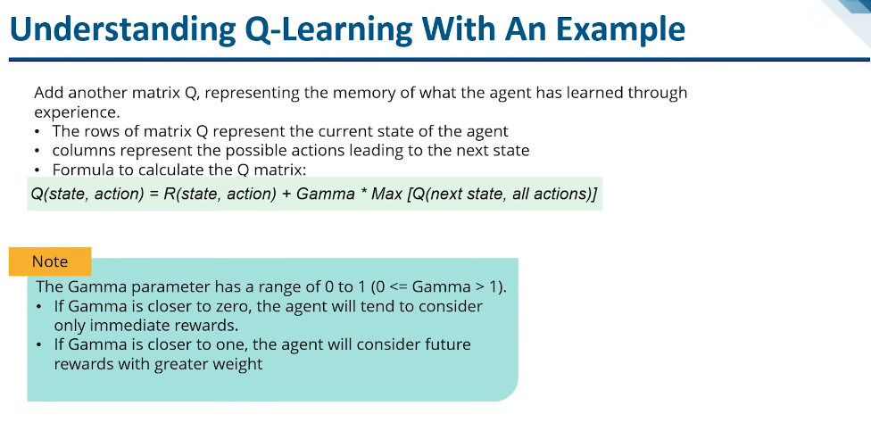
What is Q-Learning
AI/ML Professional Training Program: INNOQUEST COHORT-1
Instructor: Mr. Ansar Rahman
Notes:
Q-learning is a model-free algorithm that teaches agents the optimal winning strategy through smart interactions with the environment.
A model-free RL algorithm that learns the value of actions to maximize rewards.
Learn a Q-Function (Q(s,a)) that predicts the expected reward for taking action a in state s.

Slide 37
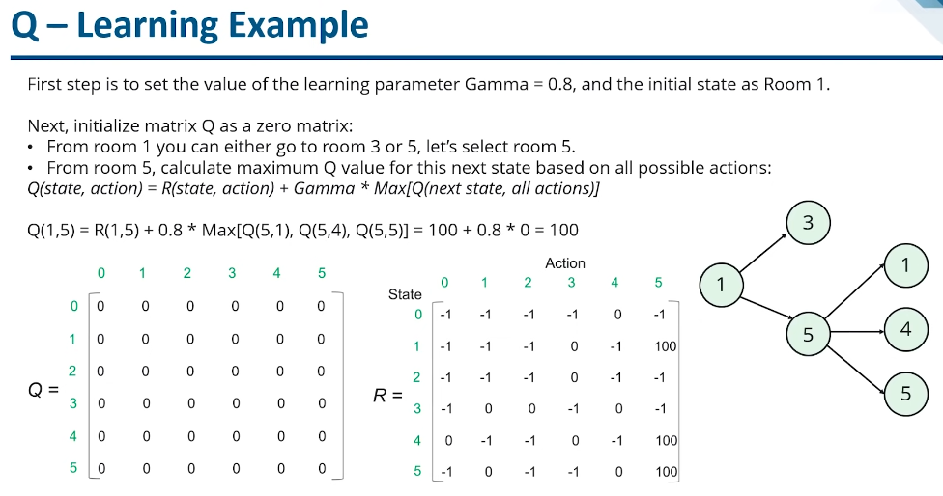
What is Q-Learning
AI/ML Professional Training Program: INNOQUEST COHORT-1
Instructor: Mr. Ansar Rahman
Notes:
Q-learning is a model-free algorithm that teaches agents the optimal winning strategy through smart interactions with the environment.
A model-free RL algorithm that learns the value of actions to maximize rewards.
Learn a Q-Function (Q(s,a)) that predicts the expected reward for taking action a in state s.

Slide 38
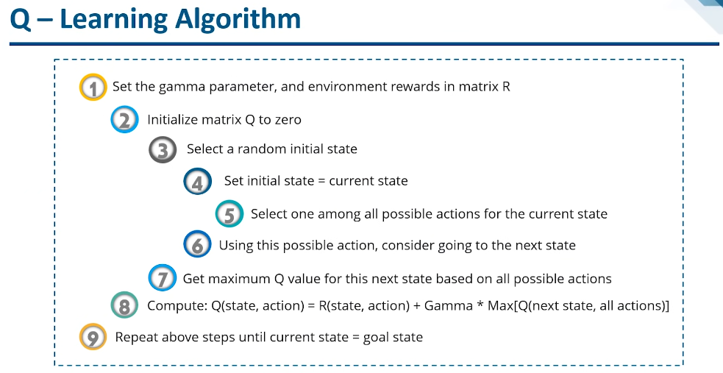
What is Q-Learning
AI/ML Professional Training Program: INNOQUEST COHORT-1
Instructor: Mr. Ansar Rahman
Notes:
Q-learning is a model-free algorithm that teaches agents the optimal winning strategy through smart interactions with the environment.
A model-free RL algorithm that learns the value of actions to maximize rewards.
Learn a Q-Function (Q(s,a)) that predicts the expected reward for taking action a in state s.

Slide 39
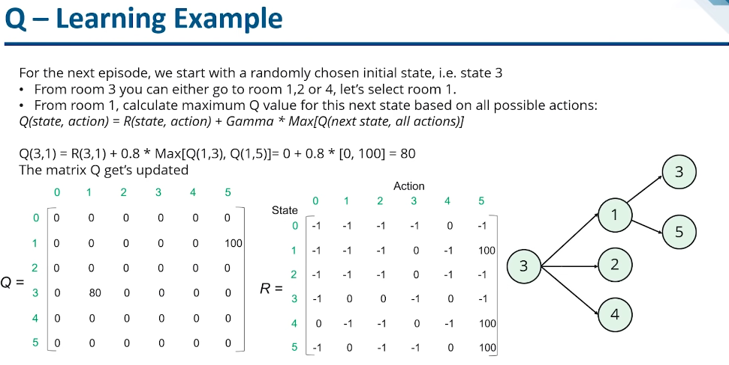
What is Q-Learning
AI/ML Professional Training Program: INNOQUEST COHORT-1
Instructor: Mr. Ansar Rahman
Notes:
Q-learning is a model-free algorithm that teaches agents the optimal winning strategy through smart interactions with the environment.
A model-free RL algorithm that learns the value of actions to maximize rewards.
Learn a Q-Function (Q(s,a)) that predicts the expected reward for taking action a in state s.

Slide 40
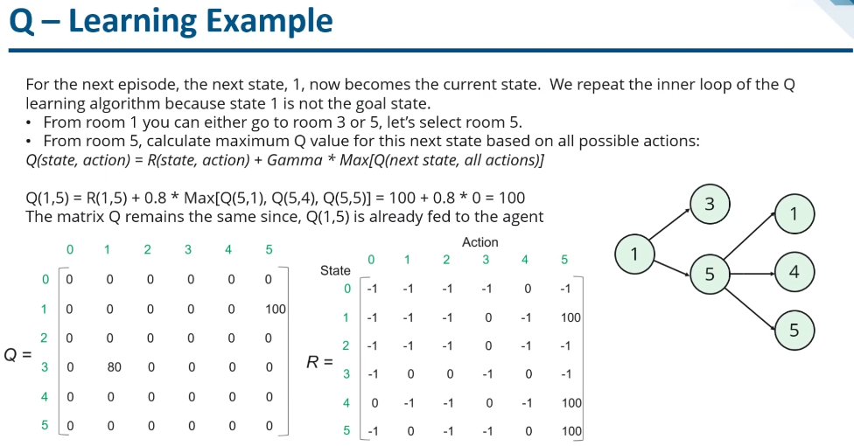
What is Q-Learning
AI/ML Professional Training Program: INNOQUEST COHORT-1
Instructor: Mr. Ansar Rahman
Notes:
Q-learning is a model-free algorithm that teaches agents the optimal winning strategy through smart interactions with the environment.
A model-free RL algorithm that learns the value of actions to maximize rewards.
Learn a Q-Function (Q(s,a)) that predicts the expected reward for taking action a in state s.

Slide 41
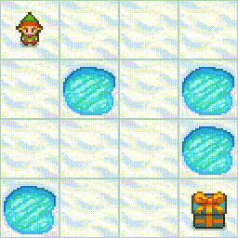

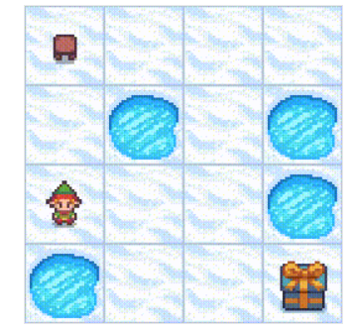
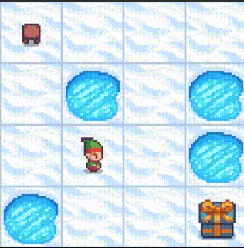
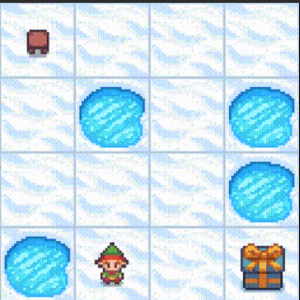
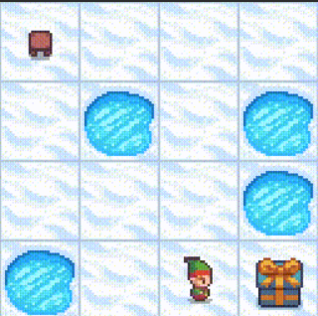
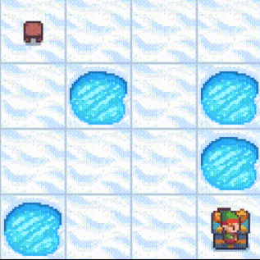
How Q-learning works by using the Frozen Lake example
AI/ML Professional Training Program: INNOQUEST COHORT-1
Instructor: Mr. Ansar Rahman
Notes:
We will learn in detail how Q-learning works by using the example of a frozen lake. In this environment, the agent must cross the frozen lake from the start to the goal, without falling into the holes. The best strategy is to reach goals by taking the shortest path.
Q-Table
The agent will use a Q-table to take the best possible action based on the expected reward for each state in the environment. In simple words, a Q-table is a data structure of sets of actions and states, and we use the Q-learning algorithm to update the values in the table.

Slide 42
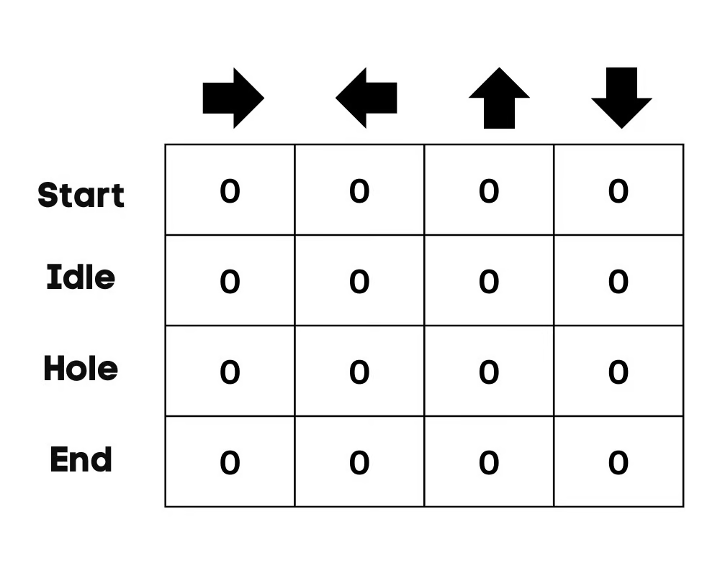
Initialize Q-Table
AI/ML Professional Training Program: INNOQUEST COHORT-1
Instructor: Mr. Ansar Rahman
Notes:
We will first initialize the Q-table. We will build the table with columns based on the number of actions and rows based on the number of states.
In our example, the character can move up, down, left, and right. We have four possible actions and four states(start, Idle, wrong path, and end). You can also consider the wrong path for falling into the hole. We will initialize the Q-Table with values at 0.
Choose an Action
The second step is quite simple. At the start, the agent will choose to take the random action(down or right), and on the second run, it will use an updated Q-Table to select the action.
Perform an Action
Choosing an action and performing the action will repeat multiple times until the training loop stops. The first action and state are selected using the Q-Table. In our case, all values of the Q-Table are zero.
Then, the agent will move down and update the Q-Table using the Bellman equation. With every move, we will be updating values in the Q-Table and also using it for determining the best course of action.
Initially, the agent is in exploration mode and chooses a random action to explore the environment. The Epsilon Greedy Strategy is a simple method to balance exploration and exploitation. The epsilon stands for the probability of choosing to explore and exploits when there are smaller chances of exploring.
At the start, the epsilon rate is higher, meaning the agent is in exploration mode. While exploring the environment, the epsilon decreases, and agents start to exploit the environment. During exploration, with every iteration, the agent becomes more confident in estimating Q-values
In the frozen lake example, the agent is unaware of the environment, so it takes random action (move down) to start. As we can see in the above image, the Q-Table is updated using the Bellman equation.

Slide 43
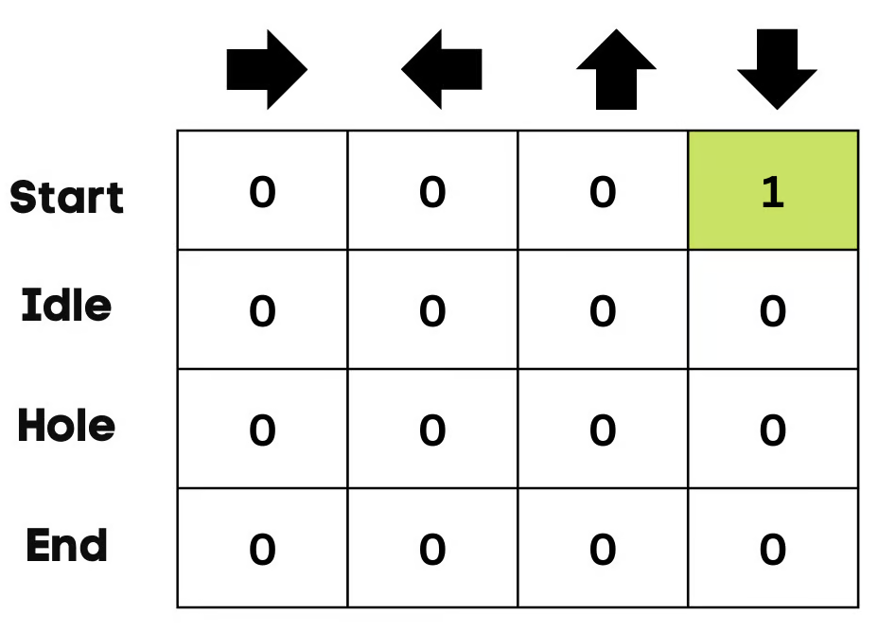
Update Q-Table
The Q-Table is updated using the Bellman equation.
Measuring the Rewards
After taking the action, we will measure the outcome and the reward.
The reward for reaching the goal is +1
The reward for taking the wrong path (falling into the hole) is 0
The reward for Idle or moving on the frozen lake is also 0.
AI/ML Professional Training Program: INNOQUEST COHORT-1
Instructor: Mr. Ansar Rahman
Notes:
In the frozen lake example, the agent is unaware of the environment, so it takes random action (move down) to start. As we can see in the above image, the Q-Table is updated using the Bellman equation.

Slide 44
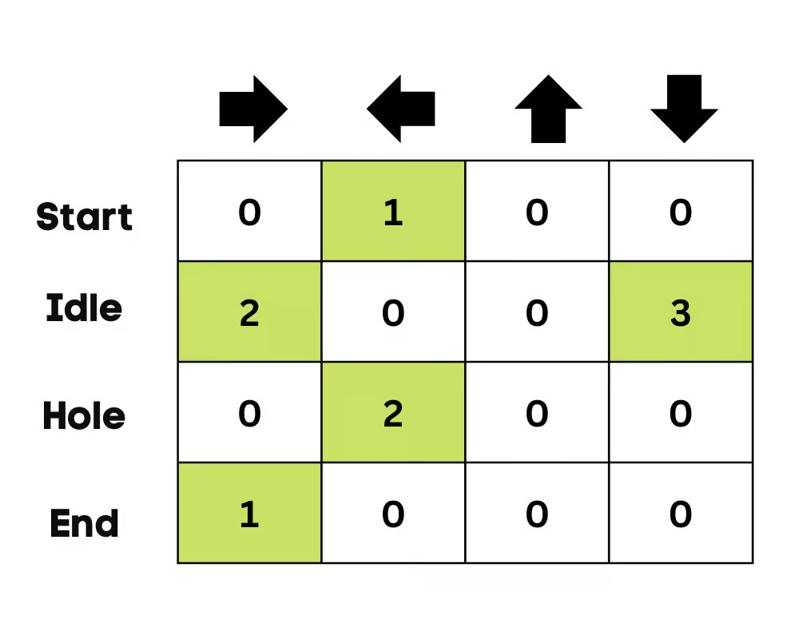
Updated Q-Table
AI/ML Professional Training Program: INNOQUEST COHORT-1
Instructor: Mr. Ansar Rahman
Notes:
At the start, the agent is exploring the environment to update the Q-table. And when the Q-Table is ready, the agent will start exploiting and start taking better decisions.
In the case of a frozen lake, the agent will learn to take the shortest path to reach the goal and avoid jumping into the holes.

Slide 45
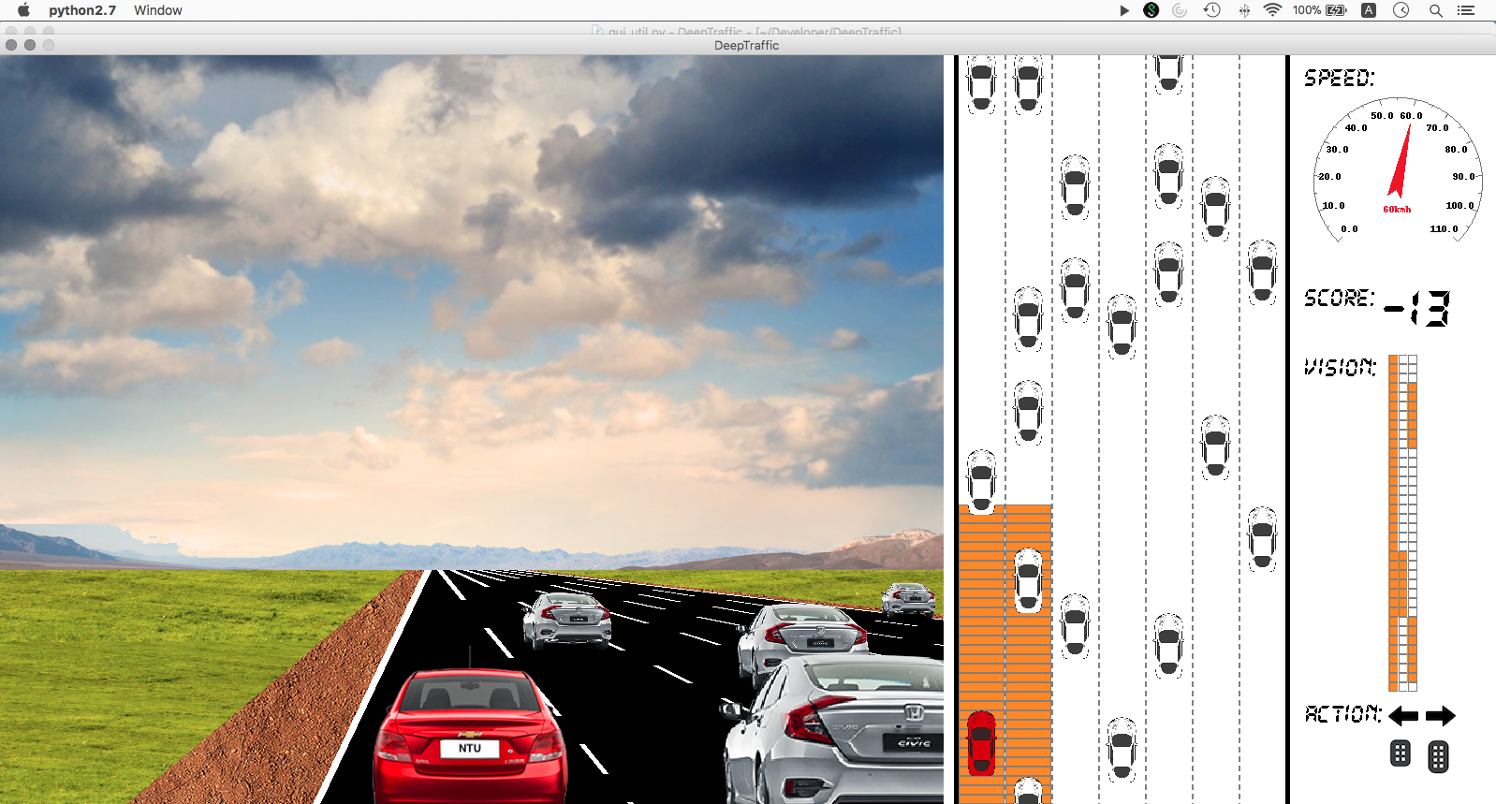
RL for Self Driving Cars
Self-driving cars: RL agents can learn optimal driving strategies based on traffic conditions and road rules.
AI/ML Professional Training Program: INNOQUEST COHORT-1
Instructor: Mr. Ansar Rahman
Notes:
Self-driving cars: RL agents can learn optimal driving strategies based on traffic conditions and road rules.

Slide 46
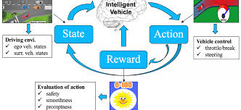
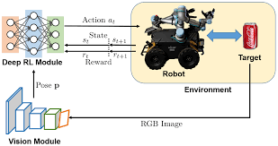
Use Cases of Reinforcement Learning
AI/ML Professional Training Program: INNOQUEST COHORT-1
Instructor: Mr. Ansar Rahman
Notes:
Robotics: Robots can be trained to perform complex tasks in dynamic environments through RL.
Game playing: AI agents can learn complex strategies in games like Go or StarCraft II using RL techniques.

Slide 47
Reference
AWS DeepRacer: https://d2k9g1efyej86q.cloudfront.net/
Machine Learning with PyTorch and Scikit-Learn (Sebastian Raschka, Yuxi Liu, Vahid Mirjalili)
https://www.datacamp.com/tutorial/reinforcement-learning-python-introduction
https://www.datacamp.com/tutorial/introduction-q-learning-beginner-tutorial
AI/ML Professional Training Program: INNOQUEST COHORT-1
Instructor: Mr. Ansar Rahman

Slide 48
Thank you

